Slide 1
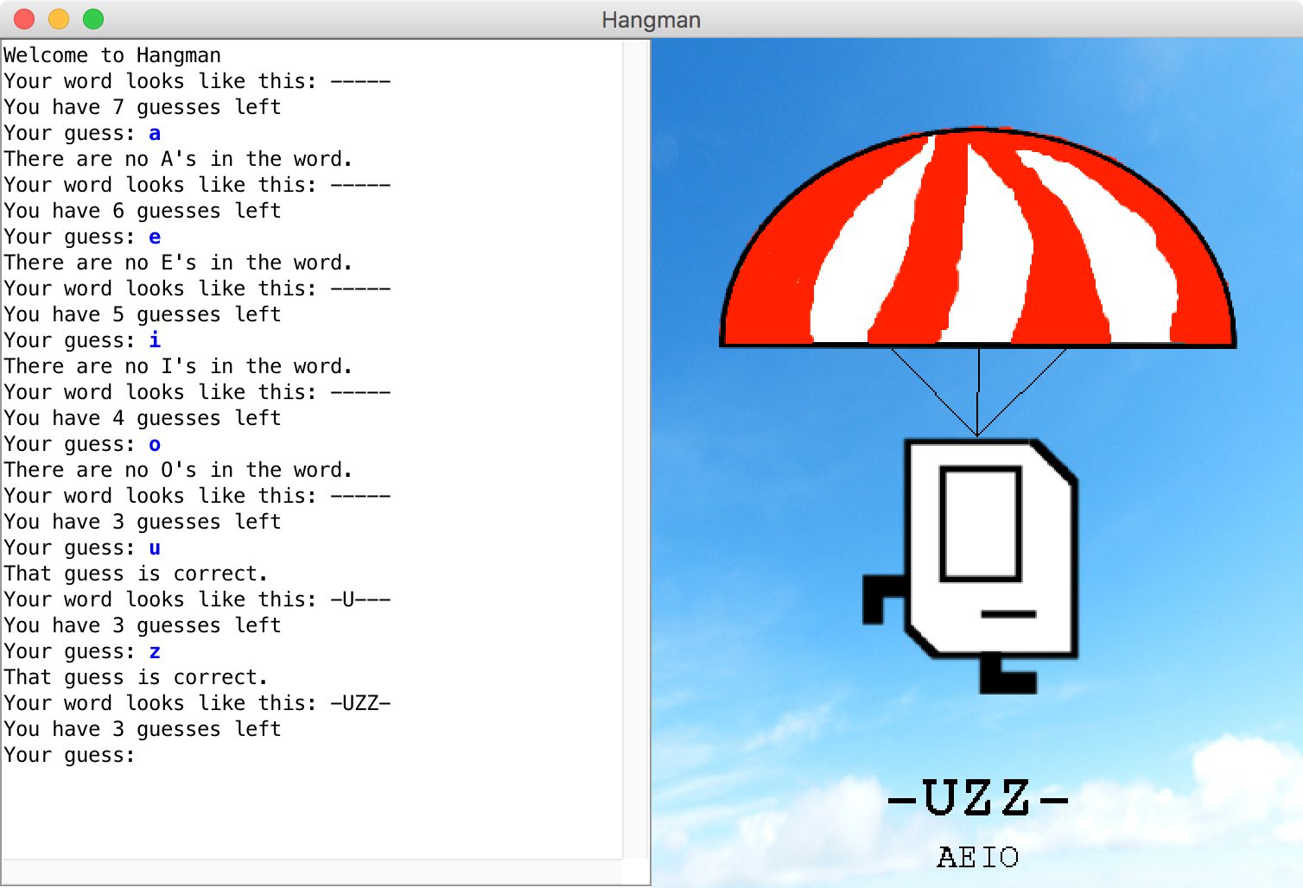

Slide 2

File Reading
Chris Piech
CS106A, Stanford University

Slide 3

Chris’ Favorite Program
Bright Simons

Slide 4
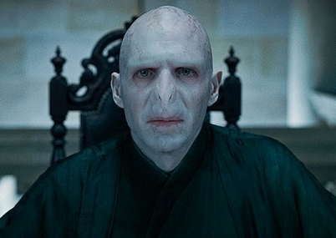
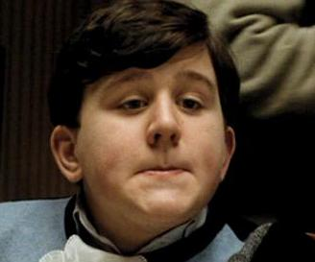

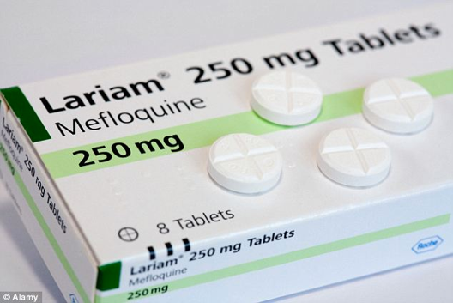
Underlying Puzzle
Counterfeiter
User
You (Distributor)

Slide 5
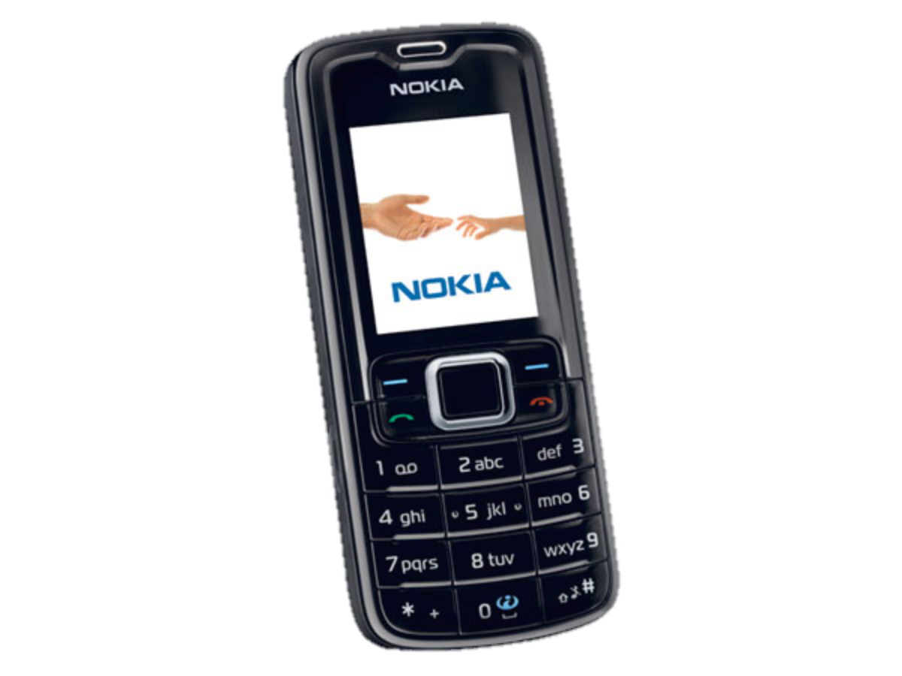
Underlying Puzzle
Counterfeiter
?
User
You (Distributor)

Slide 6
Make a code to
put on every box

Slide 8
1. Unique
2. Impossible to guess

Slide 9
Insight
So that it is impossible to guess
Concatenation
Code
=
RandomNum
+
UniqueNum
So that no two codes are the same

Slide 10
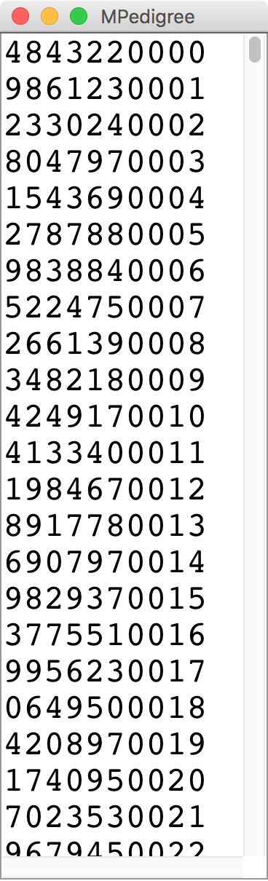
M-Pedigree

Slide 11

Learning Goals
Write string algorithms that loop over each character.
Know how to read a file line by line.

Slide 12
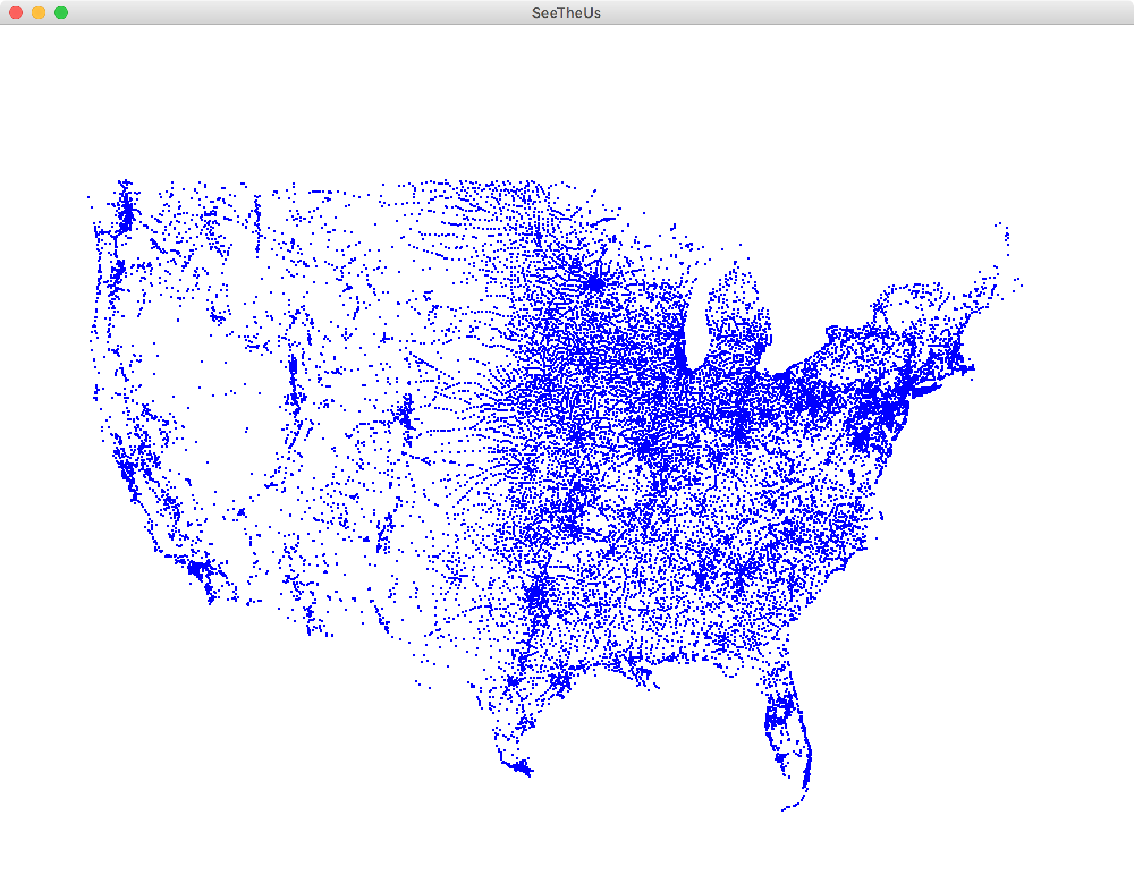
Each blue dot is a tiny GRect

Slide 13
Review

Slide 14
How is text
represented?

Slide 15
public void run() {
String text = “hello!”;
}
H
e
l
l
o
!
0
1
2
3
4
5

Slide 16
How it is actually stored
public void run() {
String text = “hello!”;
}
stack
heap?
run
28
text
28
Length: 6
H
e
l
l
o
!

Slide 17
H
e
l
l
o
!
0
1
2
3
4
5
text.charAt(index)

Slide 19
Many string algorithms use the “loop and construct” pattern.

Slide 20
Reversing a String
H
e
l
l
o
!

Slide 21
Reversing a String
H
e
l
l
o
!
H

Slide 22
Reversing a String
H
e
l
l
o
!
e
H

Slide 23
Reversing a String
H
e
l
l
o
!
l
e
H

Slide 24
Reversing a String
H
e
l
l
o
!
l
l
e
H

Slide 25
Reversing a String
H
e
l
l
o
!
o
l
l
e
H

Slide 26
Reversing a String
H
e
l
l
o
!
!
o
l
l
e
H

Slide 27
End Review

Slide 28

Palindrome
A palindrome is a string that reads the same forwards and backwards.
For example:
Abba
Racecar
Kayak
Mr. Owl ate my metal worm.
Go hang a salami! I'm a lasagna hog.
Elu par cette crapule

Slide 29
What went wrong?

Slide 30
private boolean isPalindrome(String original) {
String reversed = reverse(original);
return reversed == original;
}
stack
heap
isPalindrome
28
original
28
a
b
b
a
reversed
92
92
a
b
b
a

Slide 31
Use .equals to compare strings, not ==

Slide 32
Useful String methods
int length()
Returns the length of the string
char charAt(int index)
Returns the character at the specified index. Note: Strings indexed starting at 0.
String substring(int p1, int p2)
Returns the substring beginning at p1 and extending up to but not including p2
String substring(int p1)
Returns substring beginning at p1 and extending through end of string.
boolean equals(String s2)
Returns true if string s2 is equal to the receiver string. This is case sensitive.
int compareTo(String s2)
Returns integer whose sign indicates how strings compare in lexicographic order
int indexOf(char ch) or int indexOf(String s)
Returns index of first occurrence of the character or the string, or -1 if not found
String toLowerCase() or String toUpperCase()
Returns a lowercase or uppercase version of the receiver string
Using portions of slides by Eric Roberts

Slide 33
Some test cases
Let's test our program on some examples:
Racecar
Kayak
Mr. Owl ate my metal worm.
Go hang a salami! I'm a lasagna hog.
Will it work?
Notes:
This isn't going to work. Why not? Go to the board – are these strings really equal to their reverses?
Need to convert to lower case, for starters. Then, need to strip out everything besides letters.

Slide 34
Stress Test
A man, a plan, a caret, a ban, a myriad, a sum, a lac, a liar, a hoop, a pint, a catalpa, a gas, an oil, a bird, a yell, a vat, a caw, a pax, a wag, a tax, a nay, a ram, a cap, a yam, a gay, a tsar, a wall, a car, a luger, a ward, a bin, a woman, a vassal, a wolf, a tuna, a nit, a pall, a fret, a watt, a bay, a daub, a tan, a cab, a datum, a gall, a hat, a tag, a zap, a say, a jaw, a lay, a wet, a gallop, a tug, a trot, a trap, a tram, a torr, a caper, a top, a tonk, a toll, a ball, a fair, a sax, a minim, a tenor, a bass, a passer, a capital, a rut, an amen, a ted, a cabal, a tang, a sun, an ass, a maw, a sag, a jam, a dam, a sub, a salt, an axon, a sail, an ad, a wadi, a radian, a room, a rood, a rip, a tad, a pariah, a revel, a reel, a reed, a pool, a plug, a pin, a peek, a parabola, a dog, a pat, a cud, a nu, a fan, a pal, a rum, a nod, an eta, a lag, an eel, a batik, a mug, a mot, a nap, a maxim, a mood, a leek, a grub, a gob, a gel, a drab, a citadel, a total, a cedar, a tap, a gag, a rat, a manor, a bar, a gal, a cola, a pap, a yaw, a tab, a raj, a gab, a nag, a pagan, a bag, a jar, a bat, a way, a papa, a local, a gar, a baron, a mat, a rag, a gap, a tar, a decal, a tot, a led, a tic, a bard, a leg, a bog, a burg, a keel, a doom, a mix, a map, an atom, a gum, a kit, a baleen, a gala, a ten, a don, a mural, a pan, a faun, a ducat, a pagoda, a lob, a rap, a keep, a nip, a gulp, a loop, a deer, a leer, a lever, a hair, a pad, a tapir, a door, a moor, an aid, a raid, a wad, an alias, an ox, an atlas, a bus, a madam, a jag, a saw, a mass, an anus, a gnat, a lab, a cadet, an em, a natural, a tip, a caress, a pass, a baronet, a minimax, a sari, a fall, a ballot, a knot, a pot, a rep, a carrot, a mart, a part, a tort, a gut, a poll, a gateway, a law, a jay, a sap, a zag, a tat, a hall, a gamut, a dab, a can, a tabu, a day, a batt, a waterfall, a patina, a nut, a flow, a lass, a van, a mow, a nib, a draw, a regular, a call, a war, a stay, a gam, a yap, a cam, a ray, an ax, a tag, a wax, a paw, a cat, a valley, a drib, a lion, a saga, a plat, a catnip, a pooh, a rail, a calamus, a dairyman, a bater, a canal – Panama!
Notes:
Try this in our checker – it should work!

Slide 35
Really test your programs!
Here are some palindromes in other languages:
بلح تعلق تحت قلعة حلب (Dates hang underneath a castle in Halab)
여보, 안경 안보여 (Honey, I can't see my glasses)
कड़क (a loud thunderous sound)
上海自來水來自海上 (Shanghai tap water originates from "above" the ocean)
The comedian Dmitri Martin also has a routine about palindromes; check it out at https://www.youtube.com/watch?v=0hUHDIOazIU

Slide 36
ATGCTTAAACC..

Slide 37
Human Genome Project
"ATGCCAGGAC"
"GGACTTACATTTTT"
"ATTTTTGGCCGGCC"
And how we remember that the human genome has
3 billion base pairs

Slide 38
Compose Problem
strand1
"ATGCCAGGAC"
strand2
"GGACTTACATTTTT"
result
"ATGCCAGGACTTACATTTTT"
And how we remember that the human genome has
3 billion base pairs

Slide 39
Ha. Gene was working on
The Genome project ☺
Did Gene Myers define all those little pieces as constants?

Slide 40
File Processing!
Thanks Keith Schwarz for some great slides to build off!

Slide 41
Getting Data into Programs
Put it directly in the program:
Define constants holding your values.
Get it from the user:
Mouse events, readLine, etc.
Generate it randomly:
Use a RandomGenerator.
Get it from an external source.
Store it in a file and read it later.
Notes:
Use the example of entering a one-billion-base-pair DNA sequence into a program.

Slide 42
Reading Fiels
Virtually all programs that you've used at some point read files from disk:
Word processing (documents)
Web browser (cookies)
Games (saved progress)
Eclipse (Java files)
Music player (songs)

Slide 43
The structure of files
A file is just a series of bits (ones and zeros).
Those bits can have structure:
Plain-text: Bits represent characters.
JPEG: Bits encode information about the structure of an image.
MP3: Bits encode frequency information about music.
etc.

Slide 44
The structure of files
A file is just a series of bits (ones and zeros).
Those bits can have structure:
Plain-text: Bits represent characters.
JPEG: Bits encode information about the structure of an image.
MP3: Bits encode frequency information about music.
etc.

Slide 45
Yesterday, upon the stair,
I met a man who wasn’t there
He wasn’t there again today
I wish, I wish he’d go away...
- Hughes Mearns, "Antagonish"

Slide 46
Yesterday, upon the stair,
I met a man who wasn’t there
He wasn’t there again today
I wish, I wish he’d go away...
- Hughes Mearns, "Antagonish"
Step one:
Open the file for reading.

Slide 47
Yesterday, upon the stair,
I met a man who wasn’t there
He wasn’t there again today
I wish, I wish he’d go away...
- Hughes Mearns, "Antagonish"
BufferedReader br =
new BufferedReader(new FileReader("poem.txt"));

Slide 48
Yesterday, upon the stair,
I met a man who wasn’t there
He wasn’t there again today
I wish, I wish he’d go away...
- Hughes Mearns, "Antagonish"
BufferedReader br =
new BufferedReader(new FileReader("poem.txt"));
To use the BufferedReader and FileReader types, you need to
import java.io.*;

Slide 49
Yesterday, upon the stair,
I met a man who wasn’t there
He wasn’t there again today
I wish, I wish he’d go away...
- Hughes Mearns, "Antagonish"
BufferedReader br =
new BufferedReader(new FileReader("poem.txt"));

Slide 50
Yesterday, upon the stair,
I met a man who wasn’t there
He wasn’t there again today
I wish, I wish he’d go away...
- Hughes Mearns, "Antagonish"
BufferedReader br =
new BufferedReader(new FileReader("poem.txt"));

Slide 51
Yesterday, upon the stair,
I met a man who wasn’t there
He wasn’t there again today
I wish, I wish he’d go away...
- Hughes Mearns, "Antagonish"
BufferedReader br =
new BufferedReader(new FileReader("poem.txt"));
Step Two:
Read the file,
one line at a time.

Slide 52
Yesterday, upon the stair,
I met a man who wasn’t there
He wasn’t there again today
I wish, I wish he’d go away...
- Hughes Mearns, "Antagonish"
BufferedReader br =
new BufferedReader(new FileReader("poem.txt"));
String line1 = br.readLine();

Slide 53
Yesterday, upon the stair,
I met a man who wasn’t there
He wasn’t there again today
I wish, I wish he’d go away...
- Hughes Mearns, "Antagonish"
BufferedReader br =
new BufferedReader(new FileReader("poem.txt"));
String line1 = br.readLine();

Slide 54
Yesterday, upon the stair,
I met a man who wasn’t there
He wasn’t there again today
I wish, I wish he’d go away...
- Hughes Mearns, "Antagonish"
BufferedReader br =
new BufferedReader(new FileReader("poem.txt"));
String line1 = br.readLine(); // Yesterday, upon the stair,

Slide 55
Yesterday, upon the stair,
I met a man who wasn’t there
He wasn’t there again today
I wish, I wish he’d go away...
- Hughes Mearns, "Antagonish"
BufferedReader br =
new BufferedReader(new FileReader("poem.txt"));
String line1 = br.readLine(); // Yesterday, upon the stair,

Slide 56
Yesterday, upon the stair,
I met a man who wasn’t there
He wasn’t there again today
I wish, I wish he’d go away...
- Hughes Mearns, "Antagonish"
BufferedReader br =
new BufferedReader(new FileReader("poem.txt"));
String line1 = br.readLine(); // Yesterday, upon the stair,
String line2 = br.readLine();

Slide 57
Yesterday, upon the stair,
I met a man who wasn’t there
He wasn’t there again today
I wish, I wish he’d go away...
- Hughes Mearns, "Antagonish"
BufferedReader br =
new BufferedReader(new FileReader("poem.txt"));
String line1 = br.readLine(); // Yesterday, upon the stair,
String line2 = br.readLine();

Slide 58
Yesterday, upon the stair,
I met a man who wasn’t there
He wasn’t there again today
I wish, I wish he’d go away...
- Hughes Mearns, "Antagonish"
BufferedReader br =
new BufferedReader(new FileReader("poem.txt"));
String line1 = br.readLine(); // Yesterday, upon the stair,
String line2 = br.readLine(); // I met a man who wasn't there

Slide 59
Yesterday, upon the stair,
I met a man who wasn’t there
He wasn’t there again today
I wish, I wish he’d go away...
- Hughes Mearns, "Antagonish"
BufferedReader br =
new BufferedReader(new FileReader("poem.txt"));
String line1 = br.readLine(); // Yesterday, upon the stair,
String line2 = br.readLine(); // I met a man who wasn't there

Slide 60
Yesterday, upon the stair,
I met a man who wasn’t there
He wasn’t there again today
I wish, I wish he’d go away...
- Hughes Mearns, "Antagonish"
BufferedReader br =
new BufferedReader(new FileReader("poem.txt"));
String line1 = br.readLine(); // Yesterday, upon the stair,
String line2 = br.readLine(); // I met a man who wasn't there
String line3 = br.readLine();

Slide 61
Yesterday, upon the stair,
I met a man who wasn’t there
He wasn’t there again today
I wish, I wish he’d go away...
- Hughes Mearns, "Antagonish"
BufferedReader br =
new BufferedReader(new FileReader("poem.txt"));
String line1 = br.readLine(); // Yesterday, upon the stair,
String line2 = br.readLine(); // I met a man who wasn't there
String line3 = br.readLine();

Slide 62
Yesterday, upon the stair,
I met a man who wasn’t there
He wasn’t there again today
I wish, I wish he’d go away...
- Hughes Mearns, "Antagonish"
BufferedReader br =
new BufferedReader(new FileReader("poem.txt"));
String line1 = br.readLine(); // Yesterday, upon the stair,
String line2 = br.readLine(); // I met a man who wasn't there
String line3 = br.readLine(); // He wasn't there again today

Slide 63
Yesterday, upon the stair,
I met a man who wasn’t there
He wasn’t there again today
I wish, I wish he’d go away...
- Hughes Mearns, "Antagonish"
BufferedReader br =
new BufferedReader(new FileReader("poem.txt"));
String line1 = br.readLine(); // Yesterday, upon the stair,
String line2 = br.readLine(); // I met a man who wasn't there
String line3 = br.readLine(); // He wasn't there again today

Slide 64
Yesterday, upon the stair,
I met a man who wasn’t there
He wasn’t there again today
I wish, I wish he’d go away...
- Hughes Mearns, "Antagonish"
BufferedReader br =
new BufferedReader(new FileReader("poem.txt"));
String line1 = br.readLine(); // Yesterday, upon the stair,
String line2 = br.readLine(); // I met a man who wasn't there
String line3 = br.readLine(); // He wasn't there again today
String line4 = br.readLine();

Slide 65
Yesterday, upon the stair,
I met a man who wasn’t there
He wasn’t there again today
I wish, I wish he’d go away...
- Hughes Mearns, "Antagonish"
BufferedReader br =
new BufferedReader(new FileReader("poem.txt"));
String line1 = br.readLine(); // Yesterday, upon the stair,
String line2 = br.readLine(); // I met a man who wasn't there
String line3 = br.readLine(); // He wasn't there again today
String line4 = br.readLine();

Slide 66
Yesterday, upon the stair,
I met a man who wasn’t there
He wasn’t there again today
I wish, I wish he’d go away...
- Hughes Mearns, "Antagonish"
BufferedReader br =
new BufferedReader(new FileReader("poem.txt"));
String line1 = br.readLine(); // Yesterday, upon the stair,
String line2 = br.readLine(); // I met a man who wasn't there
String line3 = br.readLine(); // He wasn't there again today
String line4 = br.readLine(); // I wish, I wish he'd go away...

Slide 67
Yesterday, upon the stair,
I met a man who wasn’t there
He wasn’t there again today
I wish, I wish he’d go away...
- Hughes Mearns, "Antagonish"
BufferedReader br =
new BufferedReader(new FileReader("poem.txt"));
String line1 = br.readLine(); // Yesterday, upon the stair,
String line2 = br.readLine(); // I met a man who wasn't there
String line3 = br.readLine(); // He wasn't there again today
String line4 = br.readLine(); // I wish, I wish he'd go away...

Slide 68
Yesterday, upon the stair,
I met a man who wasn’t there
He wasn’t there again today
I wish, I wish he’d go away...
- Hughes Mearns, "Antagonish"
BufferedReader br =
new BufferedReader(new FileReader("poem.txt"));
String line1 = br.readLine(); // Yesterday, upon the stair,
String line2 = br.readLine(); // I met a man who wasn't there
String line3 = br.readLine(); // He wasn't there again today
String line4 = br.readLine(); // I wish, I wish he'd go away...
String line5 = br.readLine();

Slide 69
Yesterday, upon the stair,
I met a man who wasn’t there
He wasn’t there again today
I wish, I wish he’d go away...
- Hughes Mearns, "Antagonish"
BufferedReader br =
new BufferedReader(new FileReader("poem.txt"));
String line1 = br.readLine(); // Yesterday, upon the stair,
String line2 = br.readLine(); // I met a man who wasn't there
String line3 = br.readLine(); // He wasn't there again today
String line4 = br.readLine(); // I wish, I wish he'd go away...
String line5 = br.readLine();

Slide 70
Yesterday, upon the stair,
I met a man who wasn’t there
He wasn’t there again today
I wish, I wish he’d go away...
- Hughes Mearns, "Antagonish"
BufferedReader br =
new BufferedReader(new FileReader("poem.txt"));
String line1 = br.readLine(); // Yesterday, upon the stair,
String line2 = br.readLine(); // I met a man who wasn't there
String line3 = br.readLine(); // He wasn't there again today
String line4 = br.readLine(); // I wish, I wish he'd go away...
String line5 = br.readLine(); // - Hughes Mearns, "Antagonish"

Slide 71
Yesterday, upon the stair,
I met a man who wasn’t there
He wasn’t there again today
I wish, I wish he’d go away...
- Hughes Mearns, "Antagonish"
BufferedReader br =
new BufferedReader(new FileReader("poem.txt"));
String line1 = br.readLine(); // Yesterday, upon the stair,
String line2 = br.readLine(); // I met a man who wasn't there
String line3 = br.readLine(); // He wasn't there again today
String line4 = br.readLine(); // I wish, I wish he'd go away...
String line5 = br.readLine(); // - Hughes Mearns, "Antagonish"

Slide 72
Yesterday, upon the stair,
I met a man who wasn’t there
He wasn’t there again today
I wish, I wish he’d go away...
- Hughes Mearns, "Antagonish"
BufferedReader br =
new BufferedReader(new FileReader("poem.txt"));
String line1 = br.readLine(); // Yesterday, upon the stair,
String line2 = br.readLine(); // I met a man who wasn't there
String line3 = br.readLine(); // He wasn't there again today
String line4 = br.readLine(); // I wish, I wish he'd go away...
String line5 = br.readLine(); // - Hughes Mearns, "Antagonish"
String line6 = br.readLine();

Slide 73
Yesterday, upon the stair,
I met a man who wasn’t there
He wasn’t there again today
I wish, I wish he’d go away...
- Hughes Mearns, "Antagonish"
BufferedReader br =
new BufferedReader(new FileReader("poem.txt"));
String line1 = br.readLine(); // Yesterday, upon the stair,
String line2 = br.readLine(); // I met a man who wasn't there
String line3 = br.readLine(); // He wasn't there again today
String line4 = br.readLine(); // I wish, I wish he'd go away...
String line5 = br.readLine(); // - Hughes Mearns, "Antagonish"
String line6 = br.readLine(); // *Returns null*

Slide 74
Yesterday, upon the stair,
I met a man who wasn’t there
He wasn’t there again today
I wish, I wish he’d go away...
- Hughes Mearns, "Antagonish"
BufferedReader br =
new BufferedReader(new FileReader("poem.txt"));
String line1 = br.readLine(); // Yesterday, upon the stair,
String line2 = br.readLine(); // I met a man who wasn't there
String line3 = br.readLine(); // He wasn't there again today
String line4 = br.readLine(); // I wish, I wish he'd go away...
String line5 = br.readLine(); // - Hughes Mearns, "Antagonish"
String line6 = br.readLine(); // *Returns null*
Step Three:
Close the file.

Slide 75
Yesterday, upon the stair,
I met a man who wasn’t there
He wasn’t there again today
I wish, I wish he’d go away...
- Hughes Mearns, "Antagonish"
BufferedReader br =
new BufferedReader(new FileReader("poem.txt"));
String line1 = br.readLine(); // Yesterday, upon the stair,
String line2 = br.readLine(); // I met a man who wasn't there
String line3 = br.readLine(); // He wasn't there again today
String line4 = br.readLine(); // I wish, I wish he'd go away...
String line5 = br.readLine(); // - Hughes Mearns, "Antagonish"
String line6 = br.readLine(); // *Returns null*
br.close();

Slide 76
Let “try” it out!
Thanks Keith Schwarz for some great slides to build off!

Slide 77
There’s a “catch”
Thanks Keith Schwarz for some great slides to build off!

Slide 78
Sometimes things break
Programs sometimes encounter unexpected errors.
Sometimes these are bugs:
Dividing by zero.
Sending a message to a null object.
Sometimes these are due to external factors:
Network errors.
Missing files.

Slide 79
Exceptional cases
If Java encounters a case where it can't proceed as normal, it will cause an exception.
Java requires that your program handle certain types of exceptions.
Think of exceptions as rerouting control in an emergency:
If all goes well, program continues as usual.
If something goes wrong, handle the emergency.

Slide 80
Let “try” it out!
Thanks Keith Schwarz for some great slides to build off!

Slide 81
Let try it out!
Thanks Keith Schwarz for some great slides to build off!

Slide 82
try-ing your best
To use a method or class that might cause an exception, you need to tell Java to try its best, knowing that it might fail.

Slide 83
try-ing your best
To use a method or class that might cause an exception, you need to tell Java to try its best, knowing that it might fail.
BufferedReader br =
new BufferedReader(new FileReader("poem.txt"));
String line1 = br.readLine(); // Yesterday, upon the stair,
String line2 = br.readLine(); // I met a man who wasn't there
String line3 = br.readLine(); // He wasn't there again today
String line4 = br.readLine(); // I wish, I wish he'd go away...
String line5 = br.readLine(); // - Hughes Mearns, "Antagonish"
String line6 = br.readLine(); // *Returns null*
br.close();

Slide 84
try-ing your best
To use a method or class that might cause an exception, you need to tell Java to try its best, knowing that it might fail.
try {
BufferedReader br =
new BufferedReader(new FileReader("poem.txt"));
String line1 = br.readLine(); // Yesterday, upon the stair,
String line2 = br.readLine(); // I met a man who wasn't there
String line3 = br.readLine(); // He wasn't there again today
String line4 = br.readLine(); // I wish, I wish he'd go away...
String line5 = br.readLine(); // - Hughes Mearns, "Antagonish"
String line6 = br.readLine(); // *Returns null*
br.close();
}

Slide 85
There’s a “catch”
Thanks Keith Schwarz for some great slides to build off!

Slide 86
There’s a catch
Thanks Keith Schwarz for some great slides to build off!

Slide 87
try and catch me
If an exception occurs, you may need to tell Java to catch that exception.

Slide 88
try and catch me
If an exception occurs, you may need to tell Java to catch that exception.
try {
BufferedReader br =
new BufferedReader(new FileReader("poem.txt"));
String line1 = br.readLine(); // Yesterday, upon the stair,
String line2 = br.readLine(); // I met a man who wasn't there
String line3 = br.readLine(); // He wasn't there again today
String line4 = br.readLine(); // I wish, I wish he'd go away...
String line5 = br.readLine(); // - Hughes Mearns, "Antagonish"
String line6 = br.readLine(); // *Returns null*
br.close();
}

Slide 89
try and catch me
If an exception occurs, you may need to tell Java to catch that exception.
try {
BufferedReader br =
new BufferedReader(new FileReader("poem.txt"));
String line1 = br.readLine(); // Yesterday, upon the stair,
String line2 = br.readLine(); // I met a man who wasn't there
String line3 = br.readLine(); // He wasn't there again today
String line4 = br.readLine(); // I wish, I wish he'd go away...
String line5 = br.readLine(); // - Hughes Mearns, "Antagonish"
String line6 = br.readLine(); // *Returns null*
br.close();
} catch (IOException e) {
println("An error occurred: " + e);
}

Slide 90
try and catch me
If an exception occurs, you may need to tell Java to catch that exception.
If something
fails up here…
try {
BufferedReader br =
new BufferedReader(new FileReader("poem.txt"));
String line1 = br.readLine(); // Yesterday, upon the stair,
String line2 = br.readLine(); // I met a man who wasn't there
String line3 = br.readLine(); // He wasn't there again today
String line4 = br.readLine(); // I wish, I wish he'd go away...
String line5 = br.readLine(); // - Hughes Mearns, "Antagonish"
String line6 = br.readLine(); // *Returns null*
br.close();
} catch (IOException e) {
println("An error occurred: " + e);
}

Slide 91
try and catch me
If something
fails up here…
try {
BufferedReader br =
new BufferedReader(new FileReader("poem.txt"));
String line1 = br.readLine(); // Yesterday, upon the stair,
String line2 = br.readLine(); // I met a man who wasn't there
String line3 = br.readLine(); // He wasn't there again today
String line4 = br.readLine(); // I wish, I wish he'd go away...
String line5 = br.readLine(); // - Hughes Mearns, "Antagonish"
String line6 = br.readLine(); // *Returns null*
br.close();
} catch (IOException e) {
println("An error occurred: " + e);
}
… we immediately jump down here.

Slide 92
try and catch me
If something
fails up here…
try {
BufferedReader br =
new BufferedReader(new FileReader("poem.txt"));
String line1 = br.readLine(); // Yesterday, upon the stair,
String line2 = br.readLine(); // I met a man who wasn't there
String line3 = br.readLine(); // He wasn't there again today
String line4 = br.readLine(); // I wish, I wish he'd go away...
String line5 = br.readLine(); // - Hughes Mearns, "Antagonish"
String line6 = br.readLine(); // *Returns null*
br.close();
} catch (IOException e) {
throw e;
}
… we immediately jump down here.

Slide 93
try and catch me
If something
fails up here…
try {
BufferedReader br =
new BufferedReader(new FileReader("poem.txt"));
String line1 = br.readLine(); // Yesterday, upon the stair,
String line2 = br.readLine(); // I met a man who wasn't there
String line3 = br.readLine(); // He wasn't there again today
String line4 = br.readLine(); // I wish, I wish he'd go away...
String line5 = br.readLine(); // - Hughes Mearns, "Antagonish"
String line6 = br.readLine(); // *Returns null*
br.close();
} catch (IOException e) {
throw new RuntimeException(e);
}
… we immediately jump down here.

Slide 94
File concepts in one slide
Make a BufferedReader (lets call it br) to open a file for reading
Use br.readLine to get one line from the file
Both the above operations are “dangerous” so we need to use a try/catch loop
You can either handle the problem or throw a runtime exception
BufferedReader br = new BufferedReader(new FileReader("poem.txt"));
br.readLine(); // returns the next line, or null
try{
// live dangerously
} catch (Exception e){
// have heath insurance
}
throw new RuntimeException(“AHHHH!”);

Slide 95
lets throw it all together.
Thanks Keith Schwarz for some great slides to build off!

Slide 96
The classic file reading program.
The idiomatic “read all the lines of a file” code is shown here:
try {
BufferedReader br = /*…open the file… */
while (true) {
String line = br.readLine();
if (line == null) break;
/* … process current line … */
}
br.close();
} catch (IOException e) {
throw new RuntimeException(e);
}
Understanding this code is about 95% of what we want you to know for files in CS106A

Slide 97
US Census Data

